Slide 1


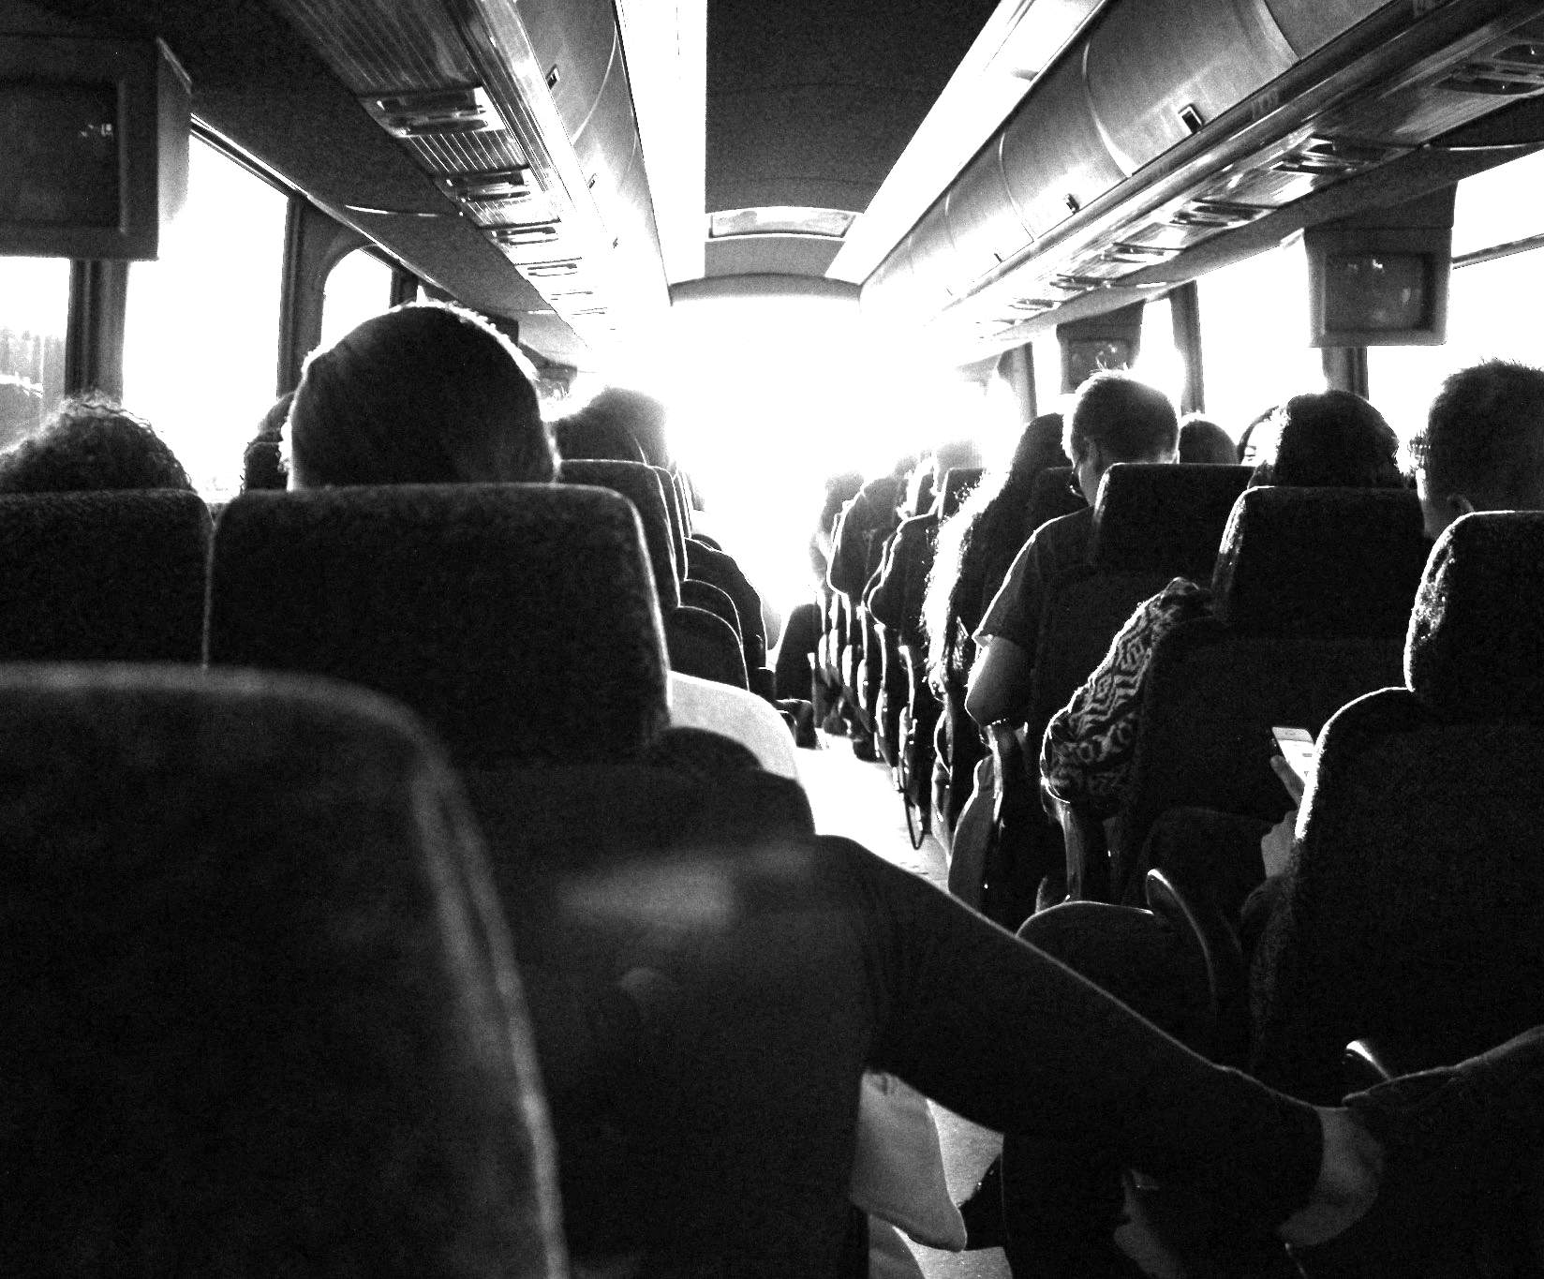
Sobek Transit
سوبيك ترانزيت
Keshav, Soliman, Badreldin

Slide 2
TABLE OF CONTENTS
01
02
03
04
05
06
The Problem
Our Solution
Major Requirements
Our team
Project stages
Future

Slide 3
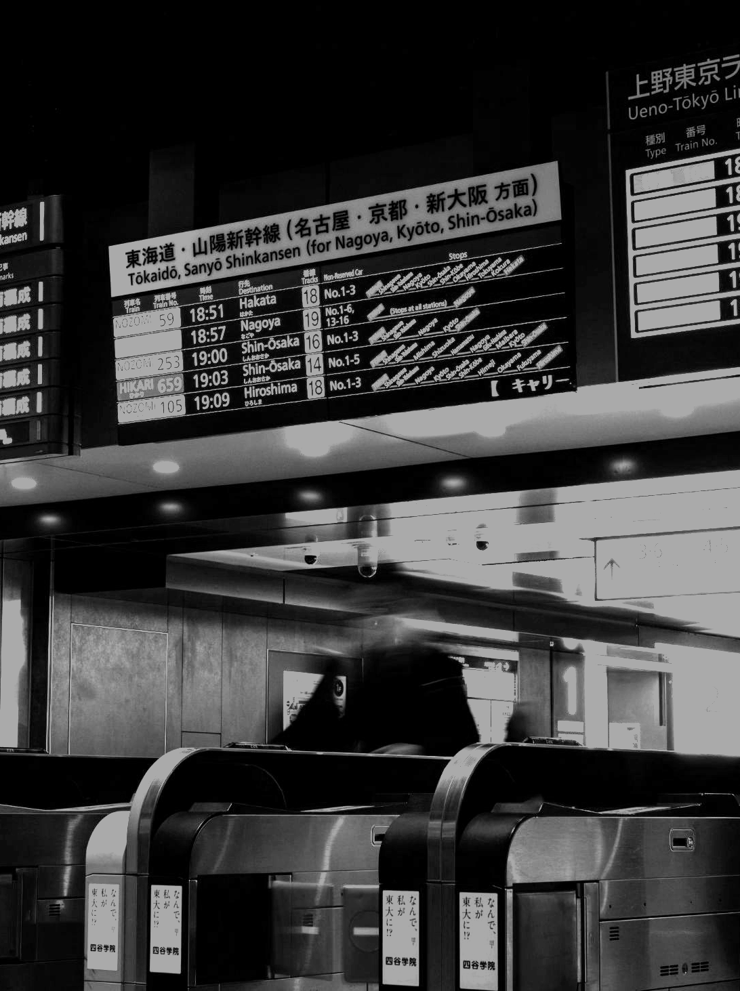
01
The Problem

Slide 4

The Problem
The current transportation system offers an inefficient and unreliable experience.
It is time consuming, lacks the means to see ride information, track the buses and link payment methods into the system.
It makes the process of managing such important process as transportation very difficult.

Slide 5
02
Our Solution

Slide 6
Our Solution
Sobek Transit system is designed to make the daily transit to and from AIU easier for everyone.
The system offers:
Online booking and cancellation support.
Estimated bus arrival and departure information.
Seat availability and route information.
Driver and overall travel experience ratings.
The ability to gather valuable user data and financial information to understand user behavior and provide better service in the future.

Slide 7



Our Solution
Web Application
A functioning website that provides information on bus stops, routes, and benefits of the app.
It also will allow users to provide feedback.
iOS App
An iOS app that provides a user-friendly experience through providing information on bus stops, routes, linking payment methods, getting an estimated arrival and departure times of different buses.
Call Support
Providing the ability to call drivers and AIU transport unit.

Slide 8
03
Major Requirements

Slide 9


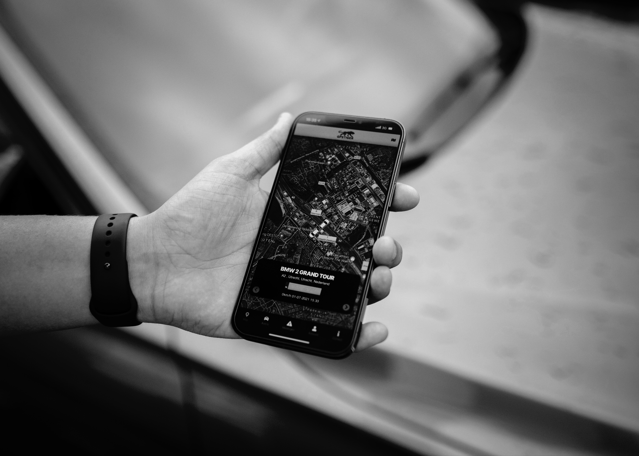
MAJOR REQUIREMENTS
Secure API + Database
Bus Tracking + Registration
Authorized connection to API endpoints with updated database.
Accurate estimation of bus tracking and regular registration update.
Payment Support
Secure and easy payment system with updated registration list.

Slide 10
04
Project Stages

Slide 11
PROJECT STAGES
Web API + Database
Setting up necessary endpoints and model database.
Website + Payment
Linking the database and the API to a user friendly website with payment system and feedback
iOS App + Estimated Bus Tracking
Easy to navigate app with bus routes on maps and seats left.

Slide 12
05
The Future

Slide 13
The Future
Live Tracking
Offline Route Information
Android Support
Automated messaging system to get bus route information, seats left, and registration.
Android App with the ability to get bus route information, register, and get support.
Live bus tracking and registration information updated every 10 seconds.

Slide 14
06
Our Team

Slide 15



Our Team
Youssef Badreldin
Muhammad Soliman
Junior Software Engineering Student at Alamein International University
Junior Software Engineering Student at Alamein International University
Keshav Bhateja
Senior Computer Science Student at Virginia Tech University

Slide 16
Thank You!
شكراً
Do you have any questions?

